Slide 1
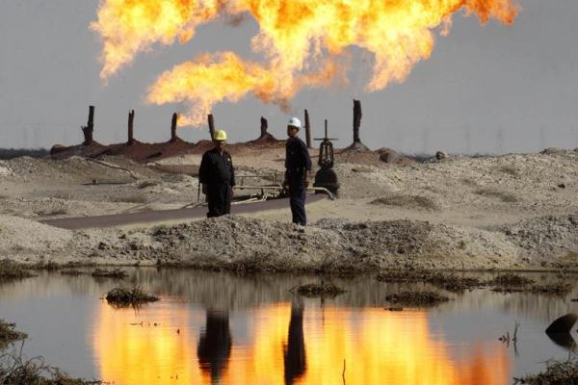
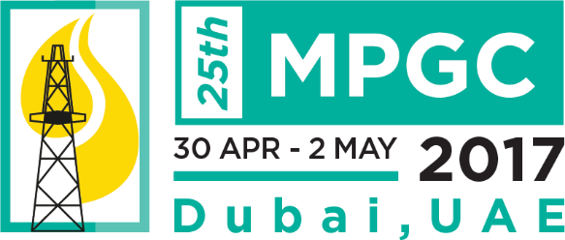
Key investment drivers in Iraq’s petroleum industry
Analysis of the commercial environment and outlook for Iraq’s oil & gas industries

Slide 2
Key investment drivers in Iraq’s petroleum industry
Contents
Overview
Market drivers
External Investment
Policies & Initiatives

Slide 3
Overview
Key investment drivers in Iraq’s petroleum industry
Key investment drivers:
Market dynamics: The impacts of a weaker global market
External investors: The relationship between Iraq and foreign stakeholders
Policies & initiatives: Steps by ALL stakeholders to improve the business environment and results
Main achievements since 2012
Production growth of approximately 50%
External investments of around $20 Billion
OPEC’s second largest producer
Risks in 2017
Weaker global petroleum market, weaker prices and budget
Growing political and economic risks at home and throughout the region
The future of its hydrocarbon sector will shape Iraq as we know it

Slide 4
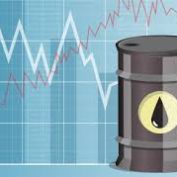
Market Drivers
Key investment drivers in Iraq’s petroleum industry
Impact of oil prices biggest driver reflecting scope of supply competition and global petroleum demand growth
Iraq’s position in the market and Relationship with OPEC?
Growing market uncertainty is a wake up call for Iraq to improve efficiency of its hydrocarbon sector
This is necessary whether Iraq expects to weather future market downturns or benefit from a balancing of the market

Slide 5
Key investment drivers in Iraq’s petroleum industry
Market drivers: SWOT of Iraq’s position in the global market
PRESENT
Strengths Among the world’s largest hydrocarbon reserves with continued growth In both oil & gas reserves Momentum of investment success, production resilience and evolving industry since 2010 Low cost producer with historically strong access to global markets | Weaknesses Volatile political conditions, likely to persist post-ISIS Weaker economic and budgetary position Evolving but weak institutional structure, unpredictable foreign investment environment
FUTURE
Opportunities Strong investment potential across hydrocarbon value chain Strong opportunities in upstream especially for smaller fields and regional projects (Iran, Kuwait) Growing opportunities in midstream (oil & gas) and downstream sectors | Threats Prolonged civil conflict and political fragmentation Worsening global conditions and deteriorating relations with global stakeholders/ investors Growing competition from region and global hydrocarbon producers

Slide 6
Market drivers: financial and commercial drivers of production
Key investment drivers in Iraq’s petroleum industry
Saudi, Iraq, Oman among most affected by drop in oil prices since 2014
Iraq needs to continue to grow production but faces other challenges in addition to lower oil prices and national budget
Further export and production growth is constrained by OPEC quotas and potential price impacts
Option to freeze exports and growing production aimed at local market constrained by limited refining capacity

Slide 7
Market drivers: Domestic refining capacities
Key investment drivers in Iraq’s petroleum industry
Refining becoming more of a strategic priority due to market downturn, loss of Beiji, domestic considerations years of neglect
Emphasis of existing refinery rehabilitations and new project proposals on the south because of better security, sea access and proximity of feedstock
Rehabilitation of existing refineries key challenge to improve quality of product barrel and minimize rising import bill
Ideas for new refinery converging around expansion of Basra into export refinery, but this workable financing and economic plan still in progress

Slide 8
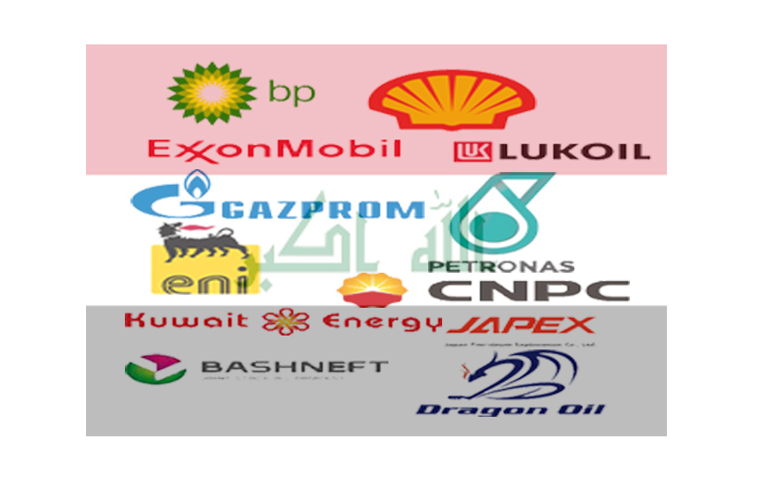
External Investment
Key investment drivers in Iraq’s petroleum industry
Market conditions increase Iraq’s dependence on external investment
Momentum of external investment and production growth challenged by worsening market conditions and relationship between Iraq and IOCs
Iraq wants IOCs to continue investing in Iraq’s future where IOCs pushing for better returns today
Negotiating more mutually acceptable contract system will focus on improving fiscal terms, minimizing payment delays, improving operating conditions

Slide 9
External Investment: Upstream investment momentum
Key investment drivers in Iraq’s petroleum industry
Despite strong growth of around 15% between 2015-2016, current forecast shows only 5% at best for 2016-2017
Adverse market conditions and Iraq’s internal problems widening the gap between Iraq and its foreign investors
Iraq pressing for continued investment momentum while investors looking for stronger immediate returns
Investors also seeking better future visibility on E&P fiscal policy and strategy
Strong Southern Production Growth
Growing National Effort Program
Declining Northern Growth
Declining Kurdish Production

Slide 10
External investment: Fiscal parameters and contract negotations
Key investment drivers in Iraq’s petroleum industry
IOCs have variable successes in Iraq – some more successful than others
High risk profiles, proactive budget and contingency planning are key factors of IOC success in Iraq
IOCs generally face more difficult cash flow challenges, but still see realistic prospects for continuing
However at least 1 out of 8 of the main IOCs are reaching divestment threshold (around IRR 15%) and could pull out if no acceptable review of contract
Net cash flow adjustment for threshold field size 18MMBLS

Slide 11
External investment: Key risks and operational priorities
Key investment drivers in Iraq’s petroleum industry
Delayed payments to IOCs further aggravate an already more difficult position since 2014
Significant repayment of arrears since in 2016 partly due to limited recovery in oil prices
Nevertheless IOCs continue to scale back staff, skilled labor and specialized resources
Therefore review of contracts likely to focus on:
Regulation of investment timing and rewards
Stronger emphasis on r-factor / sliding scales for contingency based investment scenarios

Slide 12
Policies & Initiatives (for discussion)
Key investment drivers in Iraq’s petroleum industry
Challenges – political, commercial, social and legislative issues are the challenges inhibiting any policy or initiative
Policies: Policy priorities are to continue improvements in the national institutional and legislative structures, with priority on more investor friendly fiscal framework
Initiatives cover renegotiation of existing IOC contracts, integrated upstream / midstream projects, introduction of independent oil companies, cross border E&P and midstream
Success of policies mostly an internal matter but success of initiatives depends on the relationship between Iraq and its external stakeholders

Slide 13
Policies & Initiatives: The main policy challenges
Key investment drivers in Iraq’s petroleum industry
OPERATIONAL
Human Capital: ‘Brain drain’ management vacuum
Politicization of decision processes / corruption
Antiquated management processes
Growing global competition for capital
POLITICAL
Shaky Government
Politicized state institutions
Political conflicts
Administrative inefficiencies
SOCIAL & CULTURAL
Limited understanding of private sector and investment economics
Diverse ethnic and sectarian mix (narrow social coalitions in response to failure of state institutions)
Significant poverty, chronic unemployment, under developed private sector
Poor public services, facilities and infrastructure
LEGAL & LEGISLIATIVE
No national hydrocarbon law
Reactive and inconsistent government legislation on investment in petroleum sector
Evolving fiscal framework

Slide 14
Key investment drivers in Iraq’s petroleum industry
Policies & Initiatives: Concluding remarks
CHALLENGES | DRIVERS | SCENARIO
Politics
Increasingly complex regional and Iraqi political interests - Kirkuk emerging as decisive factor for future political direction | Degree and scope in which the large regional players intervene in KRG, most significantly Russia and the US | Prolonged, low intensity conflict (50%) Further Iraqi decentralization (30%) Iraq civil war (20%)
Economics
Lower oil prices, deteriorating budget, endemic corruption and mismanagement | Restructuring domestic political and economic institutions | Mounting debt, inconsistent improvement in economic conditions
Business
Relationship with international oil investors and unrealistic fiscal framework | Institutional restructuring, leadership, improving fiscal terms | Limited improvements in fiscal framework, withdrawal of some larger IOCs, introduction of smaller independents, greater attention on midstream value chain

